Slide 1

contact@softyeducation.com

Slide 2
Day 6

Slide 3
Content :
Error handling
File manipulation
JSON
Working with folders
Exercises

Slide 4
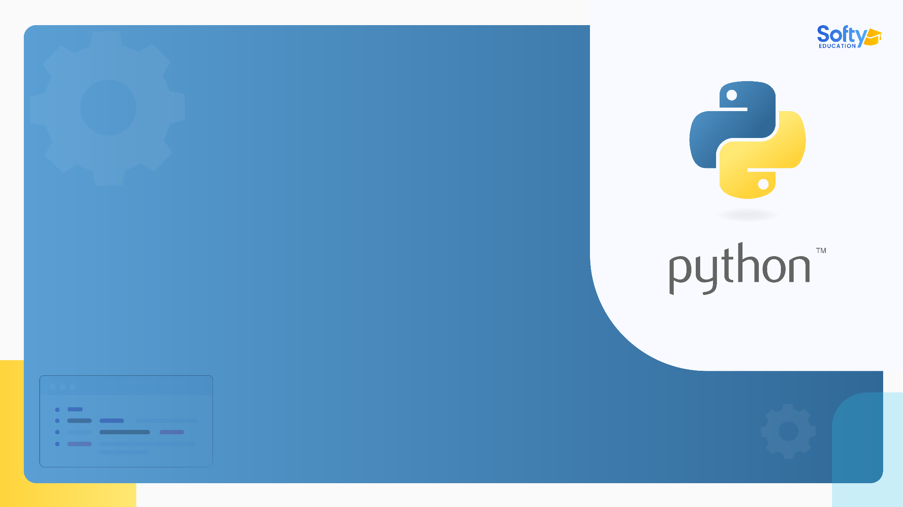
01
Error handling

Slide 5

01- Error handling
In Python, errors can occur for various reasons, such as a division by zero, accessing a non-existent key in a dictionary, or opening a non-existent file. Error handling helps in dealing with these unexpected errors and provides a way to execute code smoothly even if an error occurs.
‹#›

Slide 6
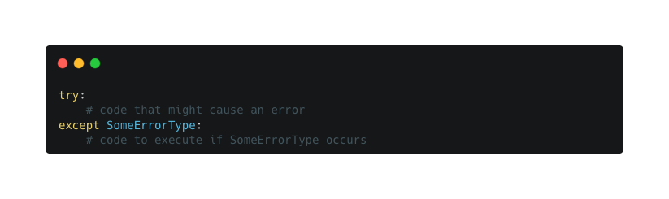
01- Error handling
The try and except Blocks
The basic structure for error handling in Python involves a try block followed by one or more except blocks.
‹#›

Slide 7
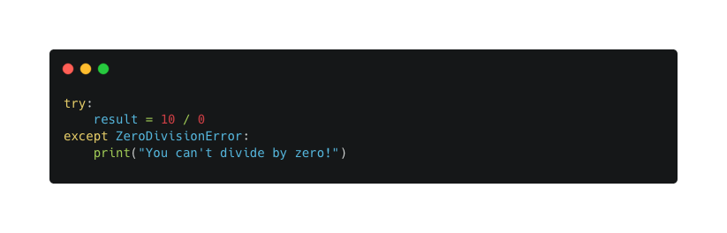
01- Error handling
Example 1: Division by Zero
Here's a common example, where an attempt to divide by zero will raise a ZeroDivisionError.
‹#›

Slide 8
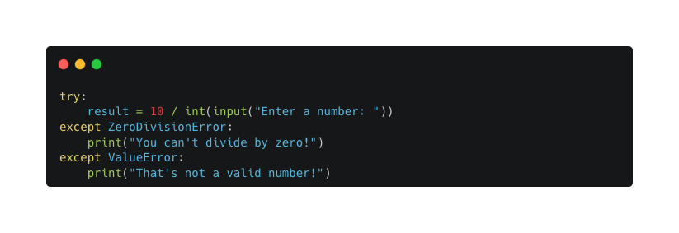
01- Error handling
Example 2: Handling Multiple Exceptions
You can handle different exceptions in separate blocks, as shown here:
‹#›

Slide 9
01- Error handling
The else and finally Clauses
You can also use else and finally clauses within error handling.
The else block is executed if no error occurs in the try block.
The finally block is always executed, whether an error occurs or not.
‹#›

Slide 10
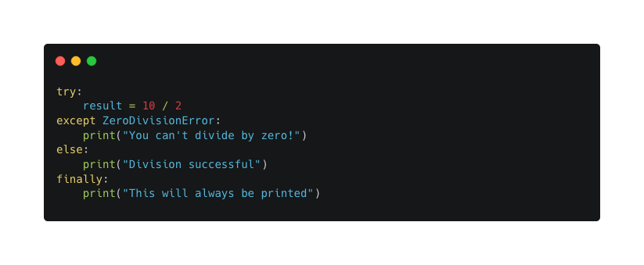
01- Error handling
‹#›

Slide 11
02
File manipulation

Slide 12
02 - File manipulation
File manipulation is a fundamental skill in programming, allowing you to read from and write to files, which is essential for data storage and retrieval. Python provides several built-in functions and methods that make file manipulation straightforward. In this article, we'll explore opening files, reading and writing data, and more.
‹#›

Slide 13
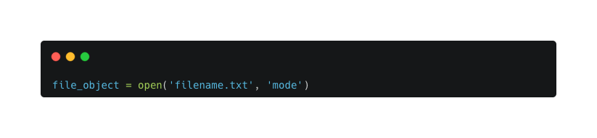
02 - File manipulation
Opening Files
To manipulate a file in Python, you first need to open it using the open function.
‹#›

Slide 14
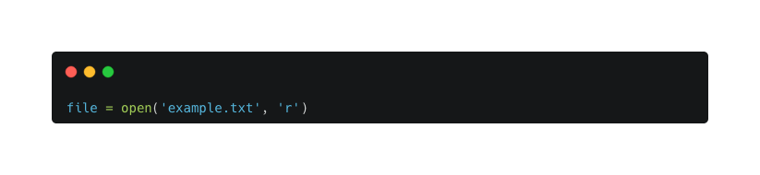
02 - File manipulation
Here, 'filename.txt' is the name of the file, and 'mode' defines how the file will be opened.
'r': Read (default). Opens the file for reading.
'w': Write. Opens the file for writing (creates a new file or truncates an existing file).
'a': Append. Opens the file for writing (creates a new file or appends to an existing file).
'b': Binary. Read/Write in binary mode.
‹#›

Slide 15
02 - File manipulation
Reading Files
Once a file is open, you can read its content using various methods.
‹#›

Slide 16
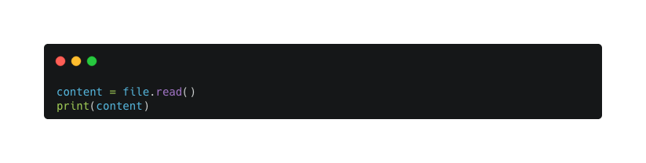
02 - File manipulation
read()
This method reads the entire file.
‹#›

Slide 17
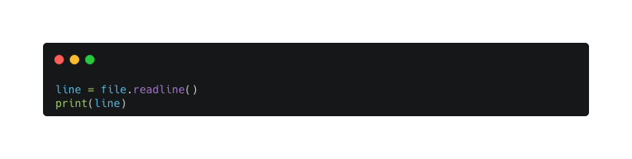
02 - File manipulation
readline()
This method reads one line at a time.
‹#›

Slide 18
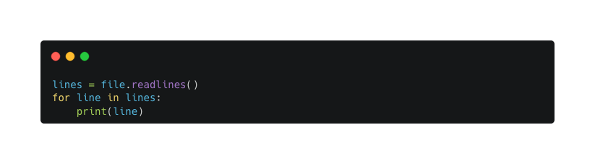
02 - File manipulation
readlines()
This method reads all the lines and returns them as a list.
‹#›

Slide 19
02 - File manipulation
Writing to Files
You can write to a file using the write and writelines methods.
‹#›

Slide 20
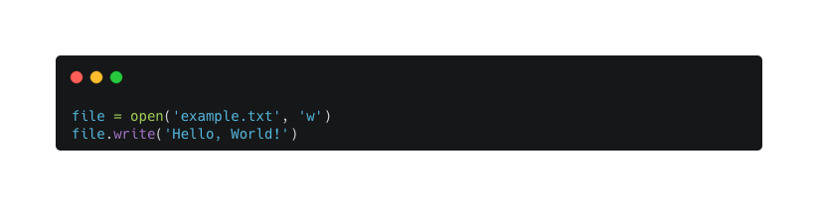
02 - File manipulation
write()
This method writes a string to the file.
‹#›

Slide 21
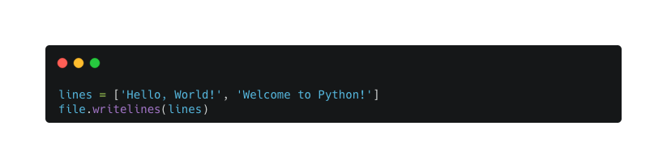
02 - File manipulation
writelines()
This method writes a list of strings.
‹#›

Slide 22
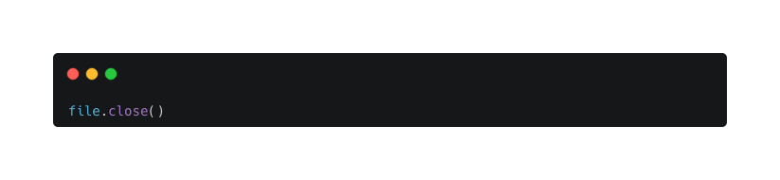
02 - File manipulation
Closing Files
It's crucial to close a file when you're done with it to free up system resources.
‹#›

Slide 23
02 - File manipulation
writelines()
This method writes a list of strings.
‹#›

Slide 24
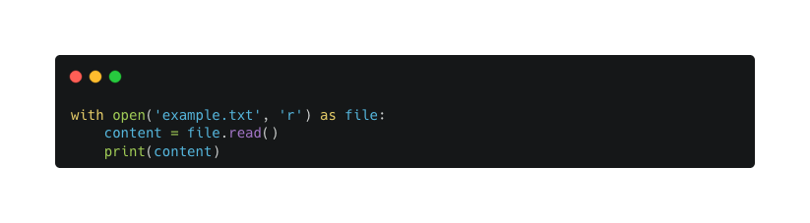
02 - File manipulation
Using with Statement
The with statement automatically takes care of closing the file, making it a safer way to handle files.
‹#›

Slide 25
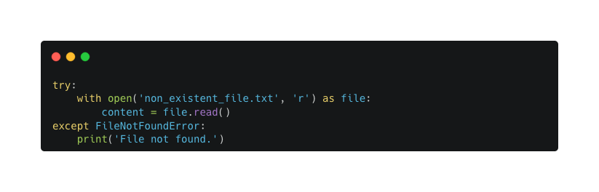
02 - File manipulation
Error Handling
Sometimes, errors can occur during file manipulation (e.g., file not found). You can handle these using a try-except block.
‹#›

Slide 26
03
JSON

Slide 27
03 - JSON
JSON (JavaScript Object Notation) is a lightweight data-interchange format that is easy for humans to read and write, and easy for machines to parse and generate. It's commonly used for exchanging data between a web server and client, but also for storing configuration and other data.
‹#›

Slide 28
03 - JSON
Python has a built-in package called json, which can be used to work with JSON data. Here's an article to help you understand how to work with JSON in Python, including reading, writing, parsing, and more.
‹#›

Slide 29
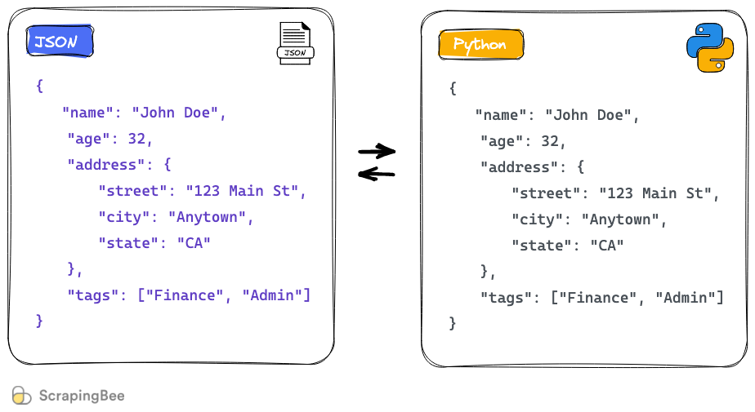
03 - JSON
‹#›

Slide 30
03 - JSON
Introduction to JSON
JSON is a text-based data format that represents structured data based on JavaScript object syntax. It is often used for asynchronous browser/server communication. A JSON object contains data in the form of key/value pairs.
‹#›

Slide 31
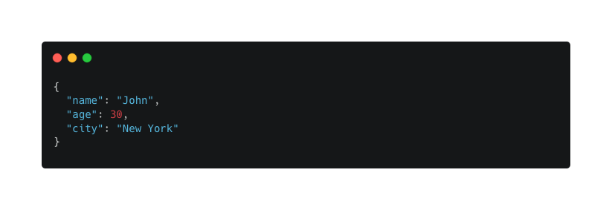
03 - JSON
A simple example of a JSON object is:
‹#›

Slide 32
03 - JSON
Using JSON in Python
Python has a built-in package called json, which can be used to work with JSON data. Here's how you can use it:
‹#›

Slide 33
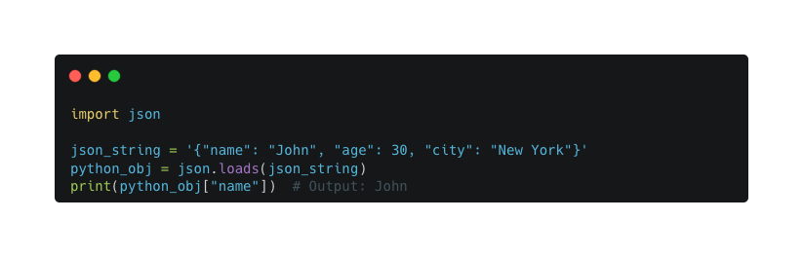
03 - JSON
Parsing JSON
You can convert a JSON string into a Python object using the json.loads() method.
‹#›

Slide 34
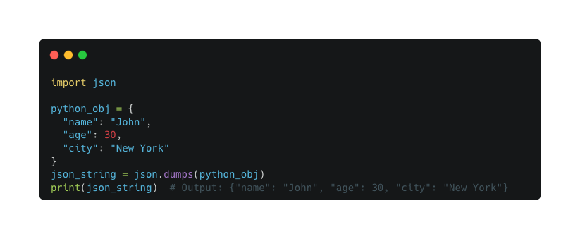
03 - JSON
Converting Python Object to JSON
You can also convert a Python object into a JSON string using the json.dumps() method.
‹#›

Slide 35
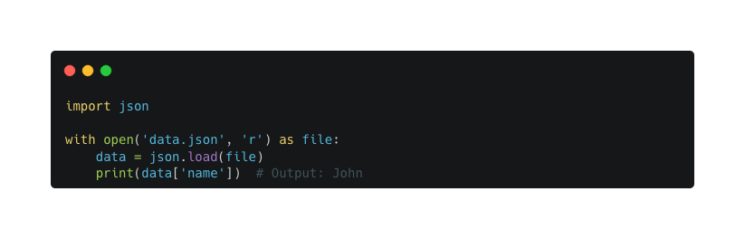
03 - JSON
Reading JSON from a File
You can read JSON data from a file using the json.load() method.
‹#›

Slide 36
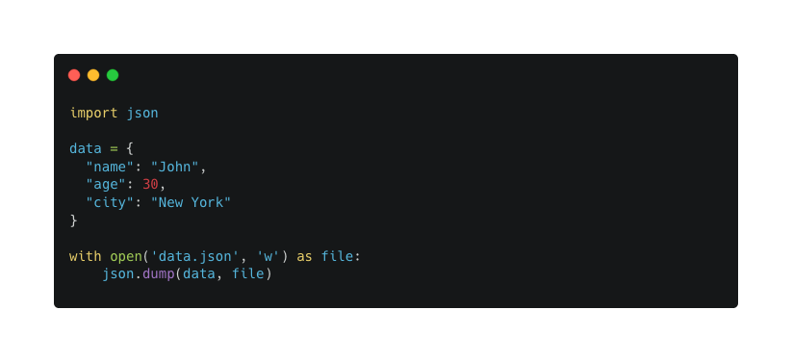
03 - JSON
Writing JSON to a File
You can write JSON data to a file using the json.dump() method.
‹#›

Slide 37
04
Working with folders

Slide 38
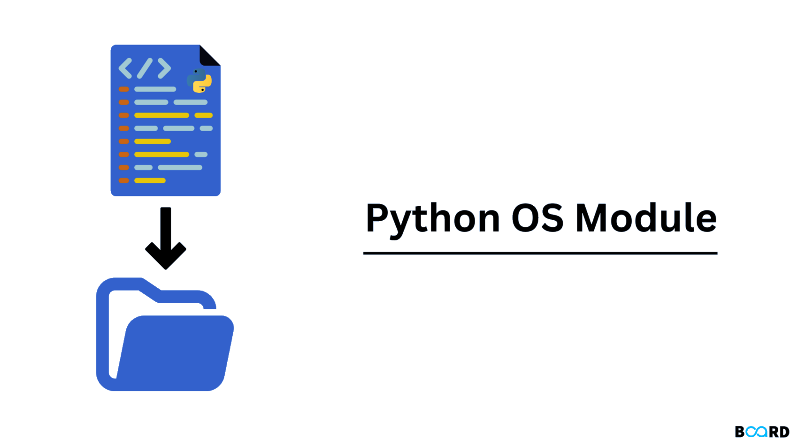
04 - Working with folders
Python offers various built-in libraries like os and shutil to work with directories and files.
‹#›

Slide 39
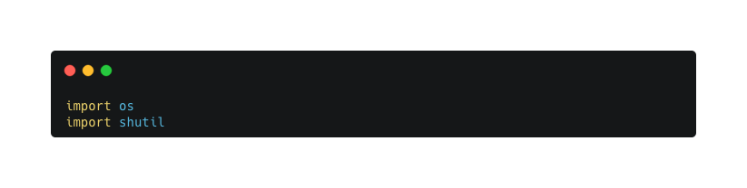
04 - Working with folders
1. Importing Necessary Libraries
Before you can work with folders, you need to import the os and shutil modules.
‹#›

Slide 40
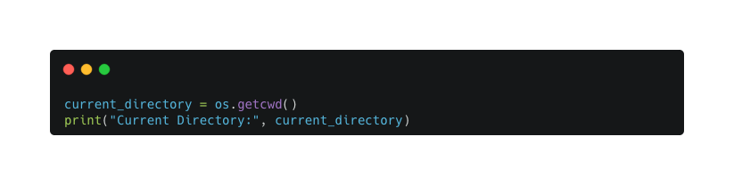
04 - Working with folders
2. Getting the Current Working Directory
You can find out the current working directory using the os.getcwd() method.
‹#›

Slide 41
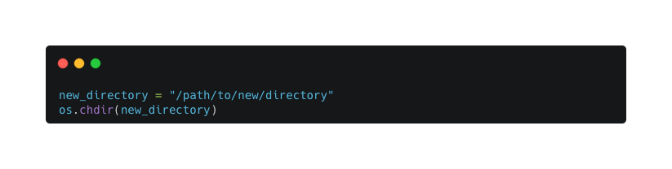
04 - Working with folders
3. Changing the Current Working Directory
You can change the working directory using the os.chdir(path) method.
‹#›

Slide 42
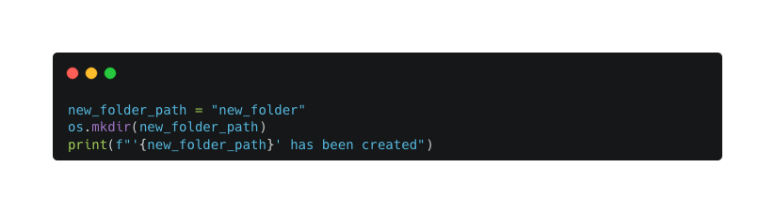
04 - Working with folders
4. Creating a New Directory
Create a new directory using the os.mkdir(path) method.
‹#›

Slide 43
04 - Working with folders
5. Listing the Contents of a Directory
Use the os.listdir(path) method to get a list of filenames in a directory.
‹#›

Slide 44
04 - Working with folders
5. Listing the Contents of a Directory
Use the os.listdir(path) method to get a list of filenames in a directory.
‹#›

Slide 45
05
Mini project

Slide 46
05 - Mini project
Project: Personal Contact Manager
The goal of this project is to create a contact manager where users can:
Add New Contacts: Store name, phone number, and email.
View All Contacts: See a list of all stored contacts.
Search for a Contact: Find a contact by name.
Update a Contact: Edit an existing contact's details.
Delete a Contact: Remove a contact from the file.
‹#›

Slide 47
Thank you

